Slide 1

A robust number plate and speech recognition system based on two way correlated method using neural network

Slide 2
Introduction
Control of vehicles is becoming a big problem
AVI systems are used for purpose of effective control
LPR is an image processing technology used to identify vehicles using only their license plate
Integration of voice recognition system provides extra layer of security for the owner.

Slide 3

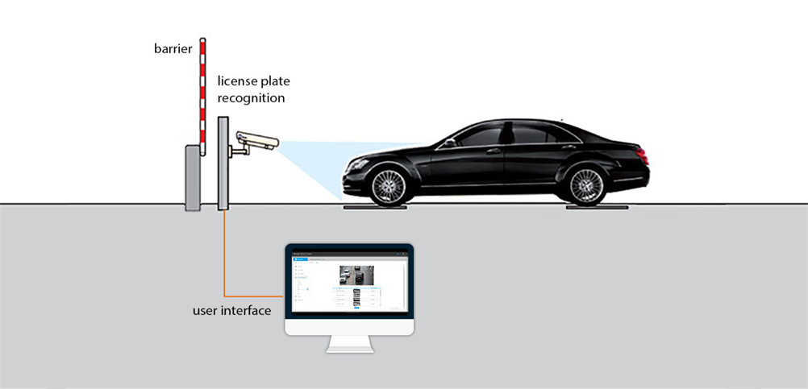
both the number plate and voice recognition are integrated together for a sophisticated secured system.

Slide 4
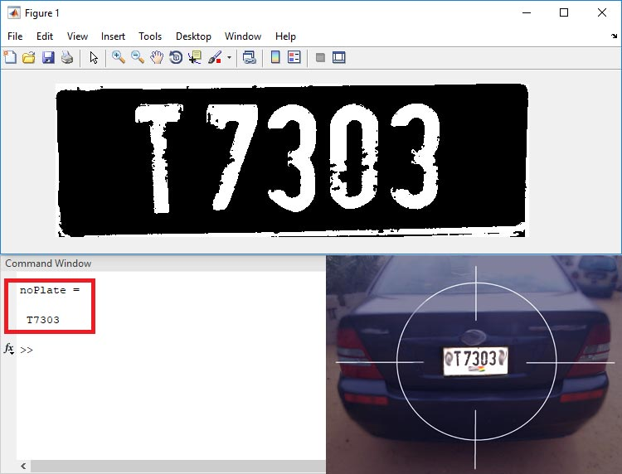
Methodology for number plate detection

Slide 5
Methodology for number plate detection
Plate Detection – Process the image and then call the above two m-files to detect the number.
Letter Detection – Reads the characters from the input image and find the highest matched corresponding alphanumeric.
Training code- This is used to call the saved images of alphanumerics and then save them as a new template in MATLAB memory.

Slide 6
Plate detection
Detects the area of interest (plate) from the whole picture
Crops the rest of the part
Image is converted to suitable format
Image is converted to gray scale
Image processing is done
Edge detection is done

Slide 7
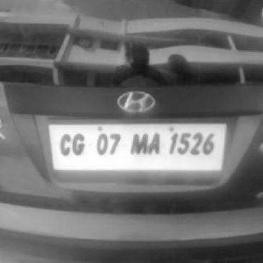
Grey scale image

Slide 8
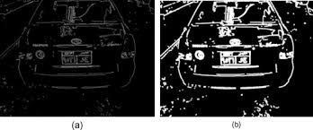
Edge detection

Slide 9
Letter detection
Letters are segmented
Alphanumeric output of input image are given
Resized the input image so that it can be compared with input image
Correlation with every image in the template is done
A matrix is created to record the value of correlation for each alphanumeric template with the characters template from the input image,

Slide 10
Training code
A preset image of every character is uploaded and saved in the library
This image is then used for comparison of input image.

Slide 11
Voice recognition steps
Two way correlation method is used in a neural network environment
This is used as PW for extra security
Using Graphical user interface the system was designed

Slide 12
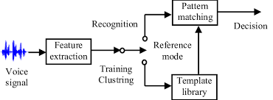
Methodology

Slide 13
Steps in chronological order
Data is created
Input is given
Output file is generated
A final algorithm is generated using neural network
Final prediction of voice recognition is done.

Slide 14
